Slide 1
Online pharmacy system
In partial of
EDUBRIDGE CAPGEMINI JAVA FULLSTACK DEVELOPER
Presented by
Arun kumar b.r
Trainer
Mr.Santhosh mali

Slide 2
TOOLS USED
HTML : Hyper Text Mark up Language
CSS : Cascading Style Sheets
CORE JAVA
Software
Eclipse IDE
Visual Studio

Slide 3
INTRODUCTION
EXISTING SYSTEM :
The customer goes to the shop and purchases the medicine required. So a lot of time is wasted and the person gets tired. If he wants to exchange the product, once again he goes to the shop and replaces them. The complete process depends on the physical interactions.

Slide 4
PROPOSED SYSTEM:
The Online Pharmacy is easy to use and order. The customer selects the required medicines and orders them by a single click. Before it, the customer needs to create a login account and fill all the details like name, address, any id no…Etc. The client can able to view the status of the medicines. The business goal for the application is to provide the medicines to all the people & admin will provide the supplier details.

Slide 5
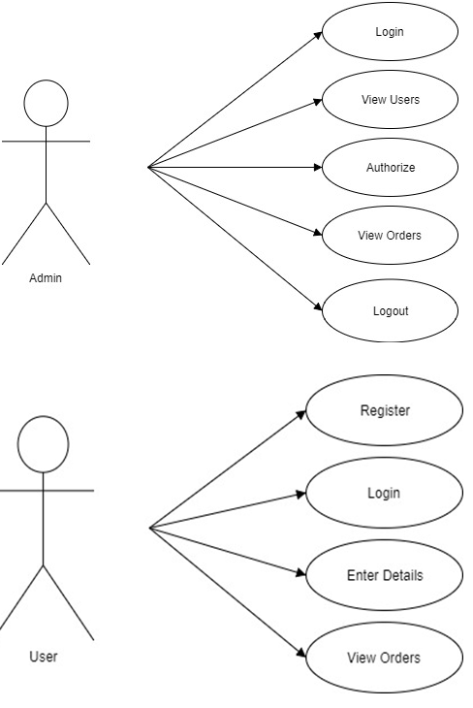
SYSTEM DESIGN – CASE DIAGRAM

Slide 6
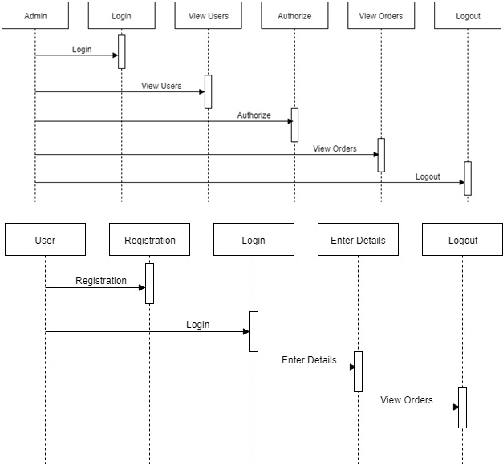
SEQUENCE DIAGRAM

Slide 7
Modules
Admin : He can able to add the new medicines information which are visible to the clients and he can view the expired medicines information and he can able to
update the medicine status.
User :User should follow the some authentication process and he can able to logging into our application by providing valid user name and password.

Slide 8
The HOME PAGE is created by Arun Kumar :
The Entire Home Page is designed using Html to create user and admin login.
It is styled using CSS to look decorative.

Slide 9
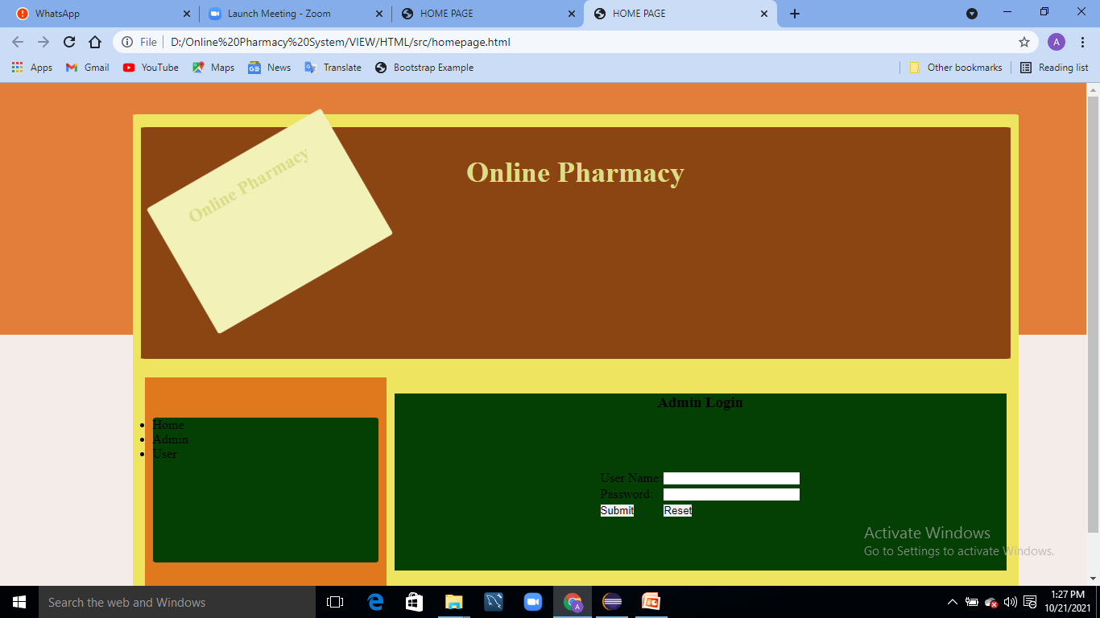
output

Slide 10
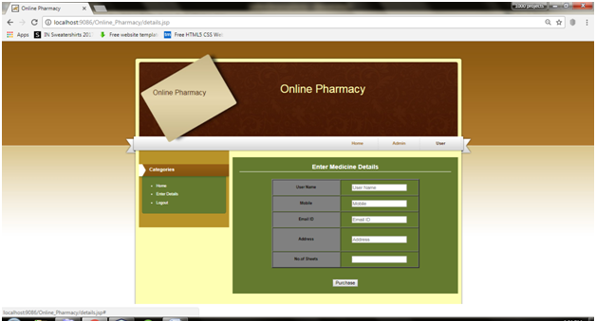

Slide 11
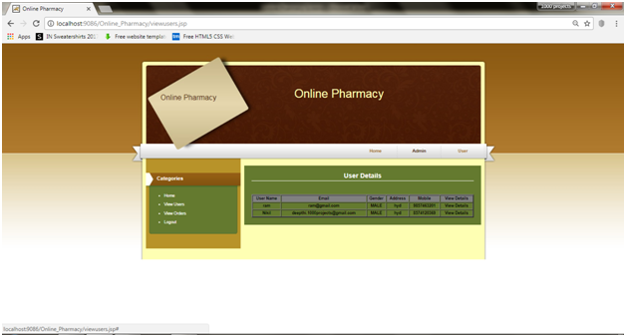

Slide 12
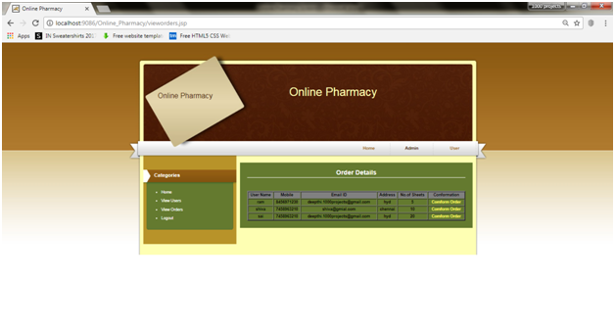

Slide 13
advantages
To provide Login facility to the customers
To provide a list of all available medicines to the customers.
To update all the list of expired medicines.
Medicines are delivered at your door-step.

Slide 14
BRIEF DESCRIPTION
The main aim of developing this application is to supply the medicines all over the country by just a single click and to reduce the time consumption. Online pharmacy is a web-based application. The user can post requirement for medicine. The User can purchase medicine online. Medicine is provided at your doorstep by the nearest associate store. The prescription is mandatory for ordering medicine. As per the prescription, the user can search medicine and useful information. This application provides information for daily consumption of medicine. This application provides user login to the customer. And admin can get the all expired medicines information and he can able to see all orders information of clients.

Slide 15
THANK YOU

